Slide 1
New Adjunct Faculty Orientation
Virtual Zoom Session
August 16, 2024
5:30 pm – 7:00 pm

Slide 2
NAFO Agenda
Welcome to USC! (5 minutes)
Just-In-Time University Resources (10 minutes)
Student Success (How do I support my students?)
Teaching Development (How can I improve, enhance, and innovate my teaching?)
Professional Development (How do I develop professionally/personally?)
Center for Teaching Excellence (30 minutes)
The hub of teaching development activities and resources at USC
Division of Information Technology (30 minutes)
eLearning Services supports classroom and academic technologies
Introduction to Blackboard (USC’s Learning Management System)
Syllabus Templates (5 minutes)
Q&A (10 minutes)

Slide 3
Just-In-Time University Resources
Matt E. Thatcher
Director
Center for Teaching Excellence

Slide 4
Student Success Resources (How Do I Support My Students?)
Absent or Disengaged?
Advising Center Referral
Failing? Financial Concerns?
Student Success Center Referral
Cheating? Disruptive Behavior?
Office of Student Conduct and Academic Integrity Report
Absence Verification?
Office of Student Advocacy Excused Absence Request
Student at Risk to Themselves or Community?
Student Care and Outreach Team (Care Team)
Discrimination, Harassment, or Sexual Misconduct?
Office of Civil Rights & Title IX - Equal Opportunity Programs Report
Needs Counseling or Psychiatry? Student Health and Well-Being Referral
Needs an Accommodations Letter? Student Disability Resource Center
Inadequate Access to Basic Needs (Food? Housing? Clothing?)
Student Care and Outreach Team (Care Team)
Don’t Know Who or What to Ask? Student Success Center
sassc@mailbox.sc.edu
803-777-1000
Crime? Accident? Suspicious Activity? Law Enforcement and Safety
USC Police Dispatch (803-777-4215)
Emergency? Call 911

Slide 5
Student Success Resources (http://sc.edu/cte)

Slide 6
Teaching Development Resources (How Can I Improve, enhance, and Innovate My Teaching?)
Center for Teaching Excellence (CTE)
Vision
Be the go-to hub that drives transformational educational experiences and fosters an institutional learning culture across the University of South Carolina.
Mission
Empower educators to innovate teaching and inspire learning.
Values
Responsiveness
Inclusivity
Collaboration
Compassion
Innovation

Slide 7
Technology Resources (How Do I Access and Use Technology?)
Division of IT
Academic Technologies
eLearning Services supports various classroom and academic technologies such as:
Blackboard
Zoom
iClicker
Lecture recording software
And more…
to meet the needs of students and faculty.

Slide 8
Professional Development (How do I develop professionally?)
Division of Human Resources
Professional Dvmt Courses
Effective Communication Certificate Program
Communicating Effectively
Difficult Conversations
Generational Differences
Conflict Resolution Skills
Emotional Intelligence
Negotiation Skills
Presenting for Results or Effective Online Presentations
Managing Yourself: A Journey to Self-Mastery
Covers emotional intelligence and other important topics
Interactive three-part series

Slide 9
Professional Development (How do I develop personally?)
Division of Human Resources
Personal Dvmt Courses
Well-Being Topics
Mindfulness in the Workplace
Building Better Mental Health
Recovery Ally
And more…
Financial Health Topics
Investing
Take Control of your Financial Future
Social Security and your Retirement
Fraud
And more….

Slide 10
Center for Teaching Excellence
Casey Carroll
Instructional Designer
Center for Teaching Excellence

Slide 11
Division of IT
Rhiannon Mayer
Director
eLearning Services
Susan Quinn
Assistant Director
eLearning Services
Katie Vaughan
eLearning Consultant

Slide 12
Syllabus Templates
Matt E. Thatcher
Director
Center for Teaching Excellence

Slide 13
Syllabus Templates
Syllabus Templates
Syllabus Templates
Face-to-Face
Online
Blended
Schedule Templates
Sample Syllabus Statements
USC Syllabus Policies

Slide 14
Summary
Just-In-Time University Resources
Student Success (How do I support my students?)
Teaching Development (How How can I improve, enhance, and innovate my teaching?)
Professional Development (How do I develop professionally/personally?)
Center for Teaching Excellence
The hub of teaching development activities and resources at USC
Division of Information Technology
Introduction to Blackboard (USC’s Learning Management System)
Syllabus Templates
Review before you start classes next week!

Slide 15
Questions?
Please
Raise your hand or
Type your question in the chat box…

Slide 16
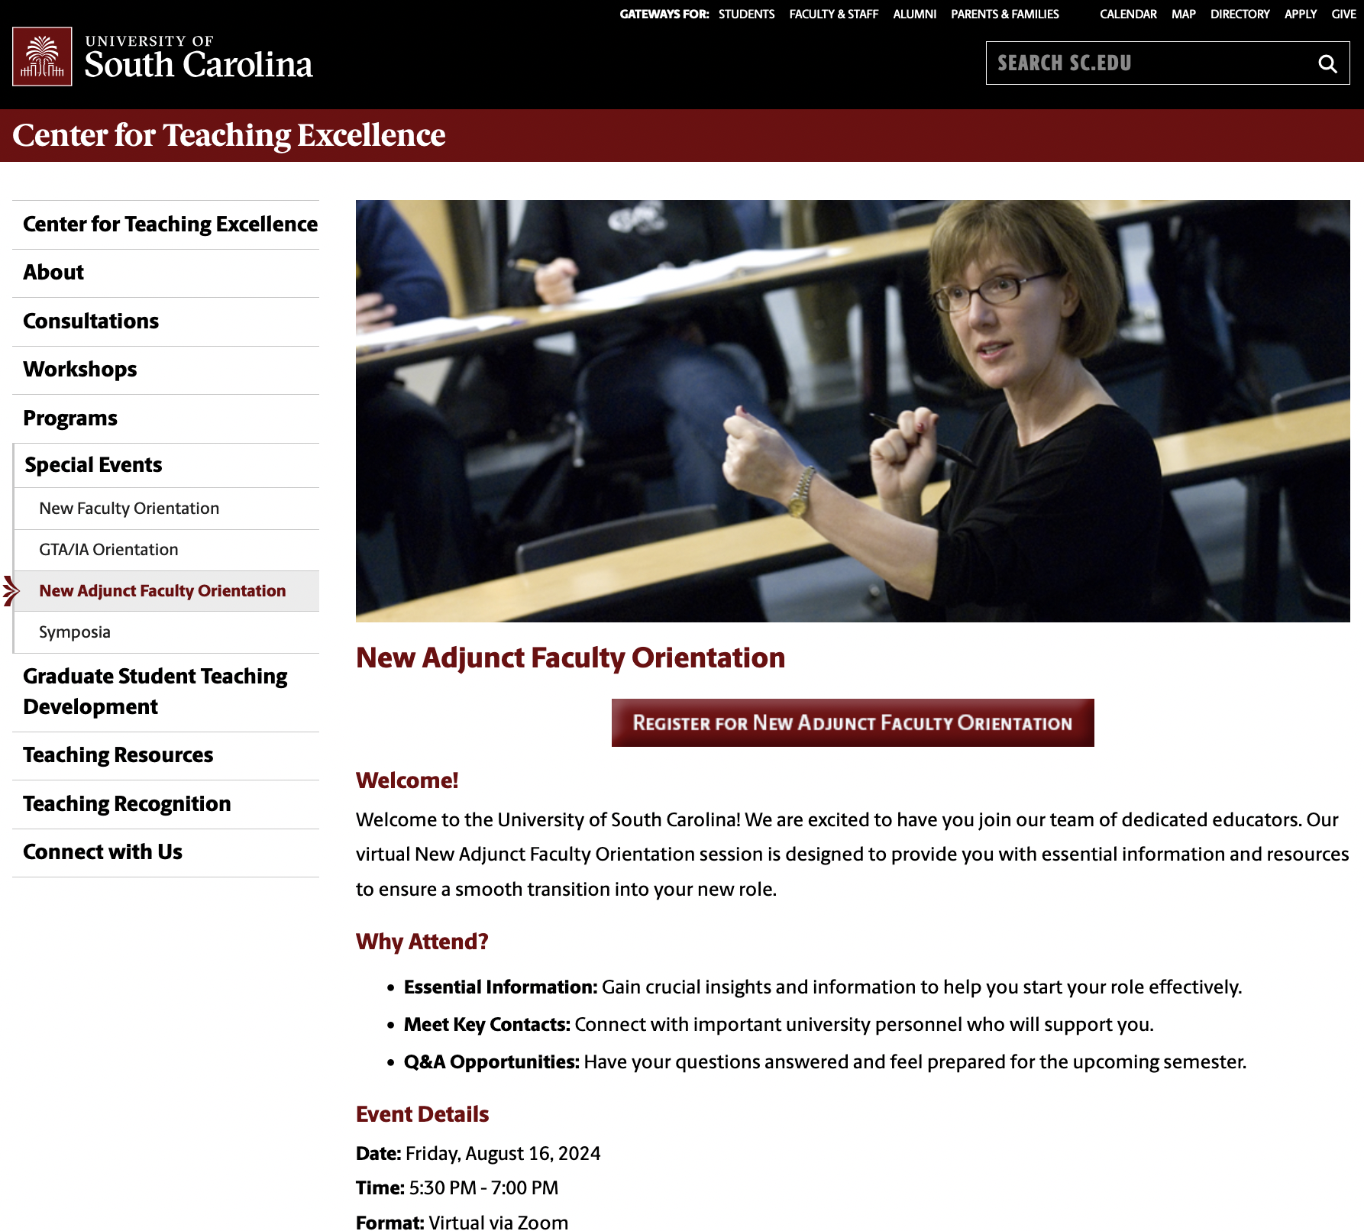
Thank You!
Please complete the evaluation
The link will be sent via email
If you have any questions, contact us at cte@sc.edu
Access the recording and slides of this NAFO presentation
http:/sc.edu/cte
Special Events
New Adjunct Faculty Orientation
Available by Tuesday, August 20

